Slide 1


RAG pattern
by RocketMind academy

Slide 2








RocketMinders
www.linkedin.com/in/luismanez
www.linkedin.com/in/rubentg
luis.manez@outlook.com
rtoribiogallardo@gmail.com
github.com/luismanez
github.com/Rtoribiog
twitter.com/luismanez
twitter.com/Rtoribiog
Luis Mañez
Ruben Toribio
RocketMind Academy CTO
RocketMind Academy CEO
Azure AI + M365 Development MVP
AI Expert / Full stack developer

Slide 3
01
Introduction

Slide 4
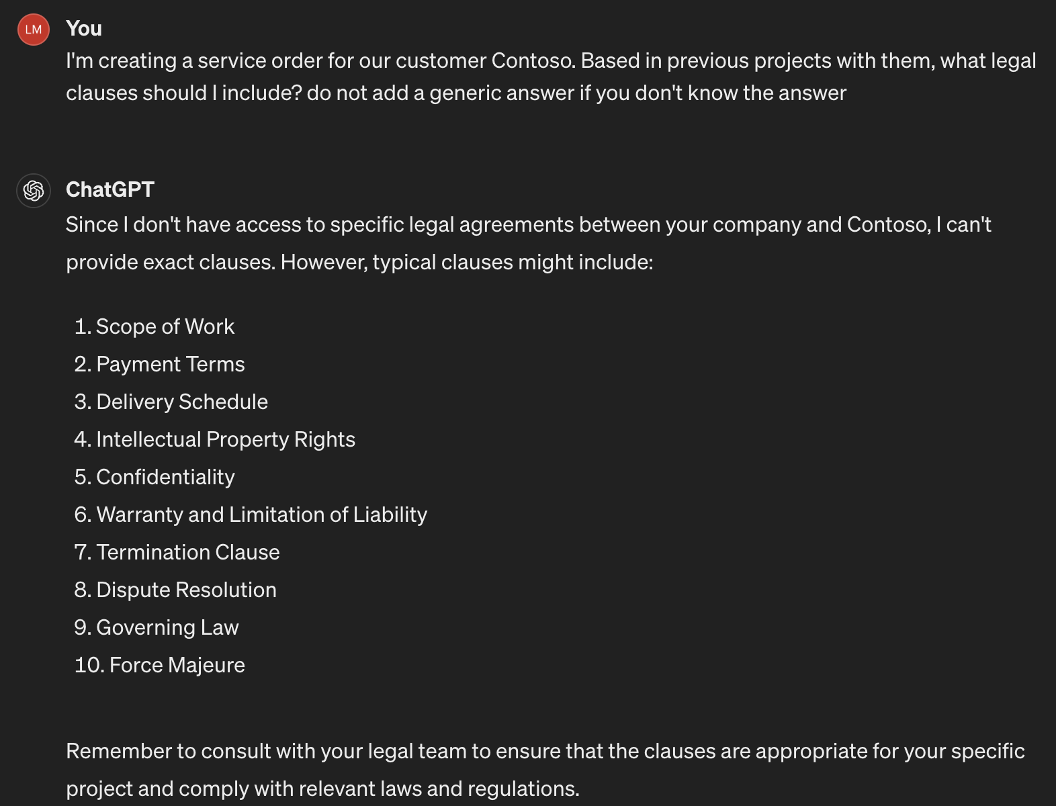
Do I need it?

Slide 5


Retrieval – Augmented - Generation
Retrieval
Augmented
Generation
Context
Based on previous service orders with Contoso you should add the following legal clauses:
Scope of Work
Payment Terms
Delivery Schedule
Contoso Service order 1
Contoso Service order 6
I'm creating a service order for our customer Contoso. Based in previous projects with them, what legal clauses should I include?
Arkham Service order 9

Slide 6

Embeddings
cat
dog
rabbit
pizza
sushi
paella
movie
cinema
[4, 5]
[3, 3.5]
[5, 3]
[2.5, -2]
[2.5, -3]
[4, -2.5]
[-3, 4]
[-1.5, 3]

Slide 7









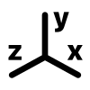













RAG Deep Dive
Documents Storage
Indexing
Text extraction
Chunking
Embeddings
Index
[-0.004828, -0.02983]
[-0.004828, -0.02983]
Chunk payload
[-0.004828, -0.02983]
Chunk Embeddings
[-0.004828, -0.02983]
Plain text
[-0.004828, -0.02983]
Metadata
………….
Retrieve
Generation
Context
[-0.004828, -0.02983]
payload + metadata 1
User query
[-0.004828, -0.02983]
[-0.004828, -0.02983]
payload + metadata 2
[-0.004828, -0.02983]
payload + metadata 3
User query

Slide 8
02
Azure AI Search introduction

Slide 9
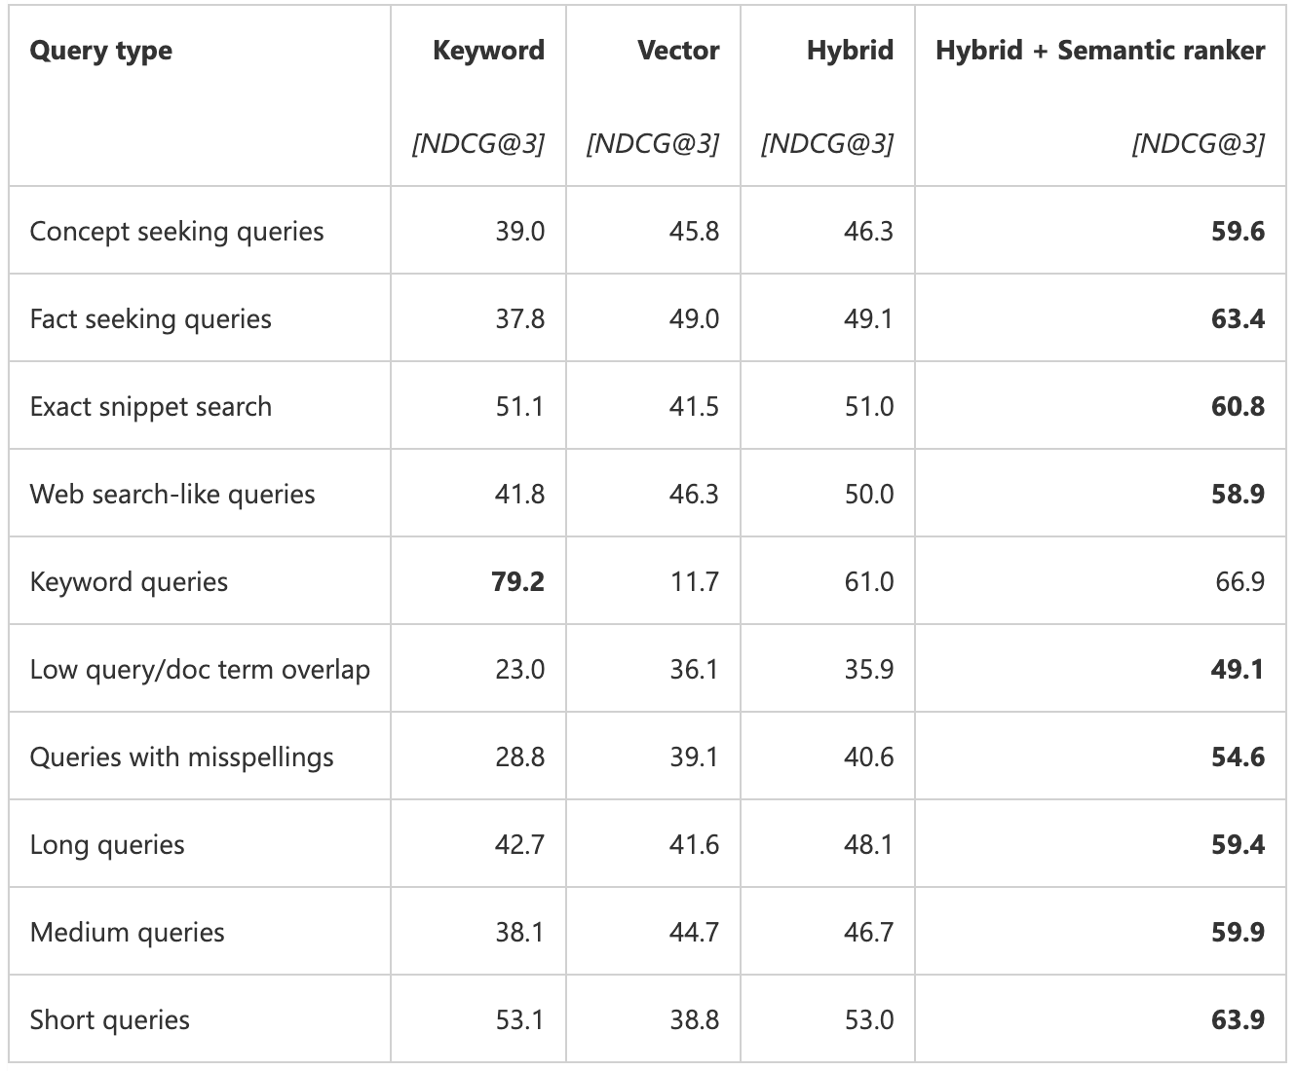
Azure AI Search
Supports Vector fields (works as Vector DB)
Allows Full-text, Vector, Hybrid and Semantic search
https://techcommunity.microsoft.com/t5/ai-azure-ai-services-blog/azure-ai-search-outperforming-vector-search-with-hybrid/ba-p/3929167

Slide 10


Full-Text Search
Spider-Man's secret identity is Peter Parker.
Spider-Man can crawl walls.
spiderman secret identity peter parker.
spiderman can crawl walls.
1
1
The AMAZING Spider-Man.
amazing spiderman.
2
2
Normalization
Sopwords
Stemming
“That was funny!!”
that funny
3
3
Word | Document | Count
spiderman
secret
identity
amazing
funny
spiderman
funny
1
2
2
1
1
3
1
1
1
1
2
2
1
3
1

Slide 11
Vector search
Nearest
Neighbours
[-0.004828, -0.02983]
[-0.004828, -0.02983]
User query
is sent to LLM
LLM
embeddings
model
query is transformed to vector
search
results

Slide 12

Hybrid Search
A single query request that includes both search and vectors query parameters
Executing in parallel
With merged results in the query response, scored using Reciprocal Rank Fusion (RRF)
1
rank: position of the document in the list
RRF =
(rank + k)
k: constant = 60
Full-text Search results
Vector Search results
Hybrid Score
Hybrid Results
Doc A
RRF = 1 / (1 +60)
Doc B
RRF = 1 / (1 + 60)
Doc A
1
+
1
0,0323
Doc B
Score: 0,0325
(1 + 60)
(3 + 60)
Doc B
RRF = 1 / (2 + 60)
Doc C
RRF = 1 / (2 + 60)
Doc B
1
+
1
0,0325
Doc A
Score: 0,0323
(2 + 60)
(1 + 60)
Doc C
RRF = 1 / (3 + 60)
Doc A
RRF = 1 / (3 + 60)
Doc C
1
+
1
0,0320
Doc C
Score: 0,0320
(3 + 60)
(2 + 60)

Slide 13


Semantic search (re-ranking)
Search Results
1
2
3
4
… …
50
Only the Top 50 results are re-ranked
Summarization Model
summary
Title field:
Product Name
Content
fields:
Product description
Product features
Ranker
Machine reading
comprehension models
Keyword
fields:
Category
Colours
@search.rerankerScore
captions
answers
@search.rerankerScore
captions
answers
* Semantic ranker is available on search services at the Basic and higher tiers

Slide 14
Github Copilot - Chat Completion
Copilot completions are powered by a Node.js-based language server (copilot-language-server.exe) that communicates with GitHub's AI models.
This process:
Gathers code context (e.g., comments, variable names, function definitions)
Sends prompts to the AI model
Receives and filters suggestions before returning them to Visual Studio
Communication between Visual Studio (.NET) and the Node process is handled using LSP (Language Server Protocol) over IPC (Inter-Process Communication).

Slide 15
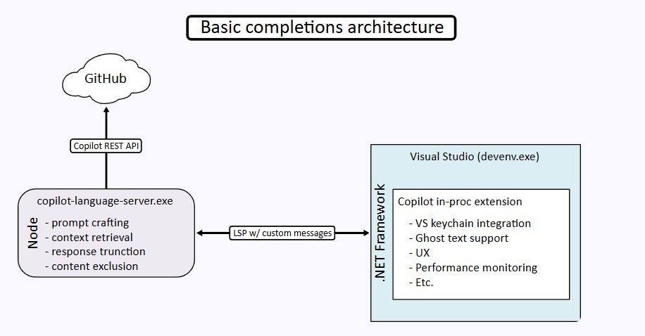
Github Copilot - Chat Completion

Slide 16
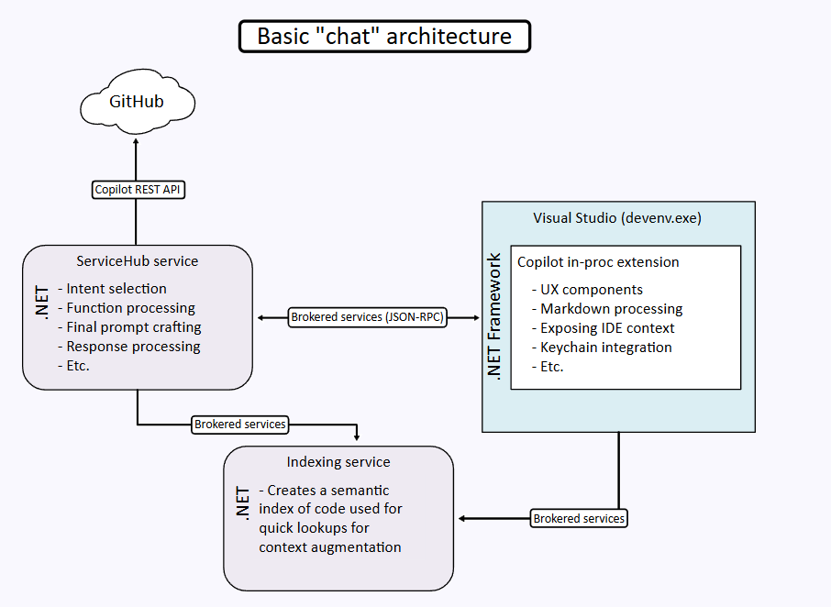
Github Copilot - Chat

Slide 17
Github Copilot - Index
A key part of Copilot’s intelligence is the semantic indexing service , which:
Builds a semantic understanding of your codebase (like types, references, symbols)
Provides accurate context to the LLM to avoid incorrect assumptions
Used in both:
Code completions
Chat and inline assistance
Ensures responses are grounded in your actual codebase, not just general training data.

Slide 18
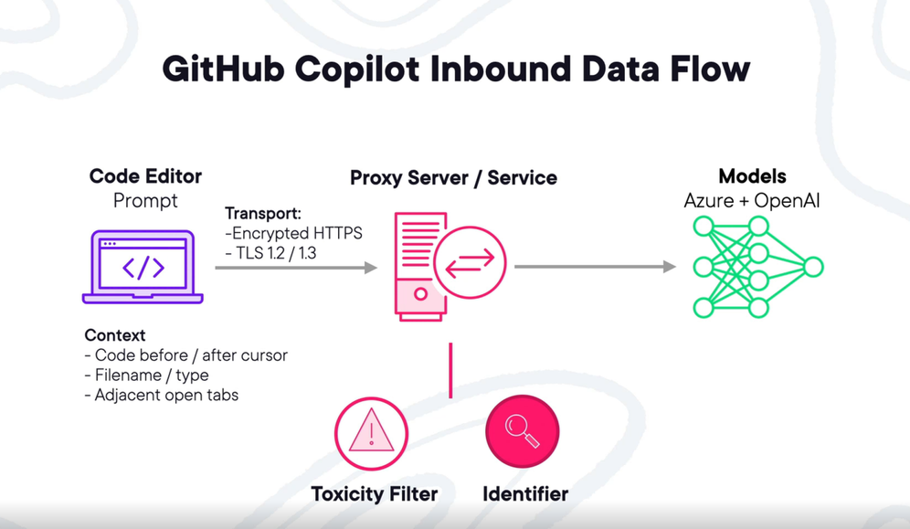
Inbound Data flow

Slide 19
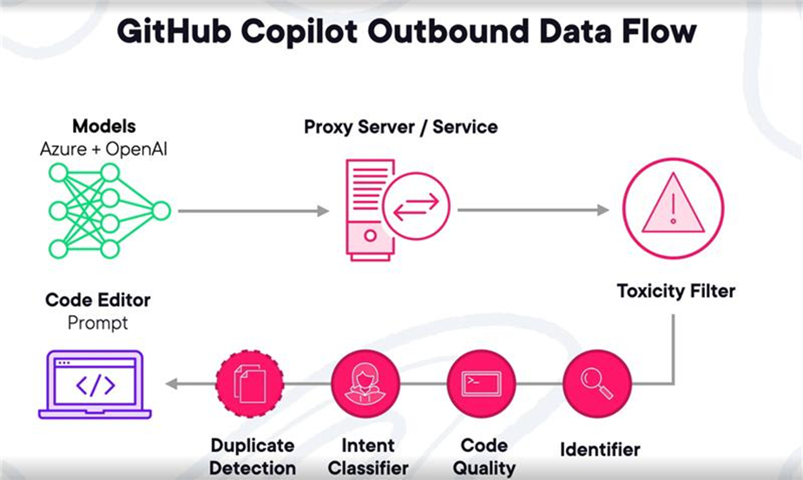
Outbound Data Flow

